Slide 1

Introduction to Python
Please stay even if you know Python, we will be covering newer aspects like type hinting and we will do our best to be brief

Slide 2
What is Python
A scripting language
Not compiled
No need for: static void main(string[] args)
Built in REPL
Accessed by running python in the terminal with no comments
Not the first choice if speed of execution is important
Could be the first choice if development speed for small programs is important

Slide 3
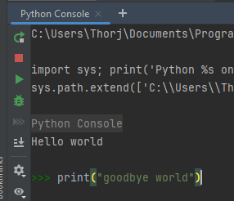
The REPL?

Slide 4
Installing Python
Version 3.13
Best support for type hinting
Faster runtime performance than older versions
https://www.python.org/downloads/

Slide 5
IDE
PyCharm (with JetBrains student license) (What I use)
https://www.jetbrains.com/community/education/#students
OR
VSCode
https://code.visualstudio.com/
Extension
https://code.visualstudio.com/docs/languages/python

Slide 6
Virtual environment (Venv) PyCharm
Ensures dependency isolation between projects
https://docs.python.org/3/tutorial/venv.html
PyCharm
Settings ->
Python interpreter ->
Add interpreter ->
Local ->
New virtual env

Slide 7
Virtual environment (Venv) VSCode
VSCode
Cd into folder where you want python venv to be located.
“python –m venv <name of virtual env>“

Slide 8
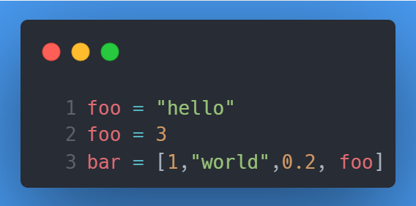
Variables
Dynamic Typing
Type is decided based on assigned value
No constants*
Functions can be assigned to variables and function names are variables

Slide 9
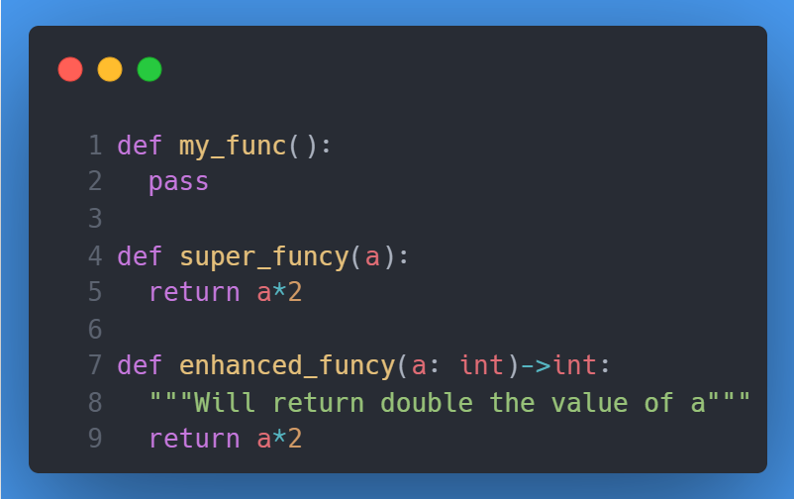
Functions
Example:
Notes:
Enhanced_funcy is better because of type hinting

Slide 10
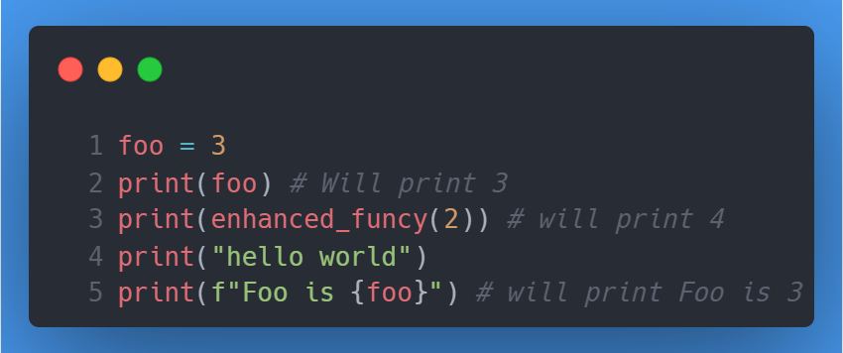
Printing
The print function
String formatting with f-strings
Dont use the old way
https://docs.python.org/3/tutorial/inputoutput.html

Slide 11
Comments
# single line comment
VsCode (Ctrl + K -> C/U)
Function documentation using """
Can be accessed in pycharm using ctrl+q

Slide 12
Running code
In terminal: python <name of file>

Slide 13
Debugging
Use the debugger. It is nice. Especially for python > 3.10
In pycharm add breakpoints then run using the bug icon
VSCode ”Ctrl + Shift + D” choose debugger of choice

Slide 14
Data types
Int
Python: ‘int’
C#: ‘int’
Float
Python: ‘float’
C#: ‘float/double’
Boolean
Python: ‘bool’
C#: ‘bool’
String
Python: ‘str’
C#: ‘string’
List
Python: ‘list’
C#: ‘ArrayList/LinkedList’
Tuple(immutable)
Python: ‘tuple’
C#: ‘ImmutableList’
Dictionary
Python: ‘dict’
C#: ‘Hashtable’
Set
Python: ‘set’
C#: ‘HashSet’
For more: https://www.w3schools.com/python/python_datatypes.asp

Slide 15
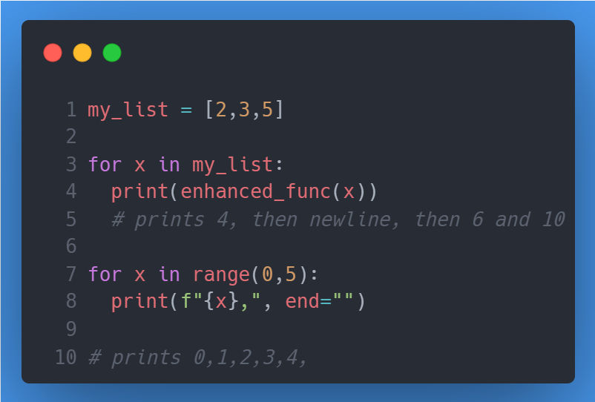
loops
For loop
The range function

Slide 16
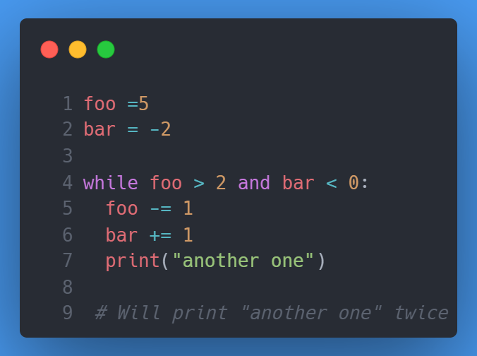
loops
While loop

Slide 17
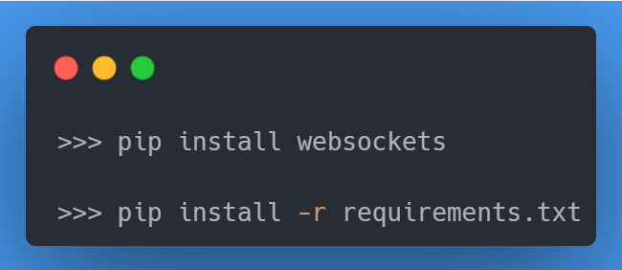
Installing dependencies
pip install <anything>
requirements.txt
https://learnpython.com/blog/python-requirements-file/
https://pip.pypa.io/en/stable/reference/requirements-file-format/

Slide 18
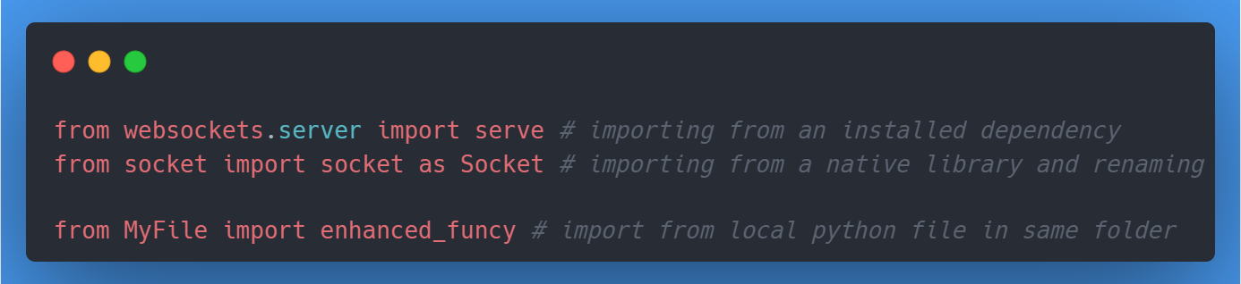
Import dependencies
Import from neighbouring files in the same directory
Import dependencies that have been installed with pip

Slide 19
Syntactic sugar
Type hinting
https://docs.python.org/3/library/typing.html
More maintainable code and less headaches
List comprehensions
https://docs.python.org/3/tutorial/datastructures.html
Concise creations of lists, that are also readable
Ternary if statements
https://www.geeksforgeeks.org/ternary-operator-in-python/
Denser code
Lambda functions
https://www.w3schools.com/python/python_lambda.asp
Anonymous functions

Slide 20
About readability
PEP
The python standard for how to write this language
Includes things like using snake_case
Type hint your code
We have done it, so you can too
Everyone will be better off from it
Write docstrings for your functions
Python as a language aims to be readable, by spelling out operations

Slide 21
And so much more
Utilizing Python to its full extent is a much much longer course
Some things we have not even grazed:
Classes
"magic" methods (__<something>__)
Inheritance
Including multiple inheritance
Async/await
Including asyncio
The GIL
Threads
Exception handling
Try
Except
The variable called __name__

Slide 22
Todays Exercises
No mandatory assignments
But! The exam will contain questions that can only be answered after having solved the exercises
The exercises are split into assignments and homework.
You are welcome to work on both while here, but we expect you to finish the assignments.
We dont expect you to finish both homework and assignments while here
We will not hand out solutions
We will only provide solutions the week after, only by showing them in class.
The assignments are in a separate pdf on itsLearning and alongside the code
The code is shared through GitLab
https://gitlab.sdu.dk/ai-course-f24/ai-course-f24-labs
Fork the repo to get your own copy, but dont open pull requests unless to fix mistakes
Next week we will show how to get your repo updated with labs2 (dont create the folders on your own)

